Slide 1
Work Out Buddy App
An app where you can be physically fit

Slide 2
Business Requirement intended to tackle:
Users
Functionality of the App
Needed for Improvement/ On process work and Development

Slide 3
Work-out Buddy Applications: USERS
Work out Buddy app was for all ages. Especially for teenagers and adults
This app emphasizes that every person can be physically fit and healthy
A variety of workouts that can be categorized from mild to heavy training exercises that can somehow be trained by adults and old

Slide 4
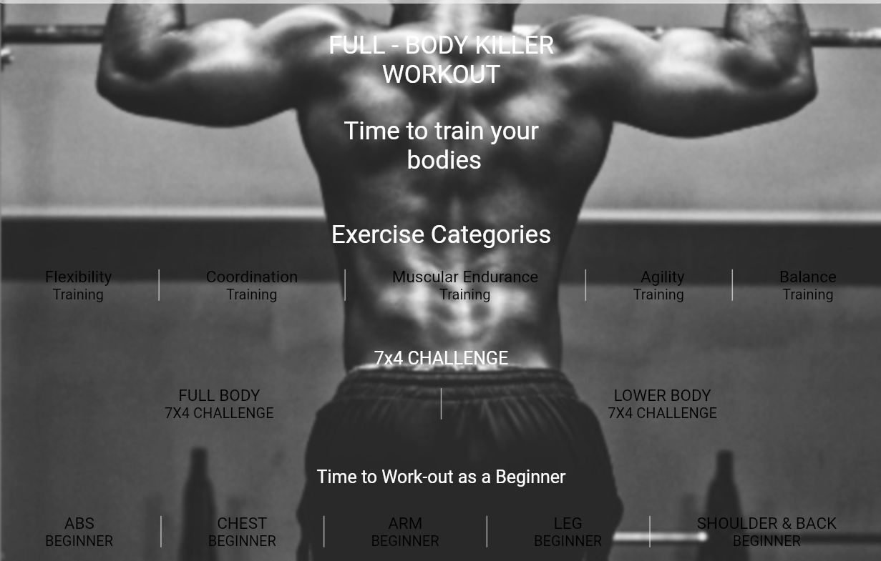
The functionality of the app: Workout Buddy Functions
Workout Buddy has the simplest functionality of all, it’s not complicated you just need to click every categorized exercise on the Home Screen.
For every click theirs a variety of training exercises that has fundamental edges on your body whether it is in your arms, legs, shoulder, etc.
Workout Buddy Manifest with its core on the drawer navigation which you can integrate your growth, schedule, and the status you have been achieving
Moreover, in the Home Screen section you can possibly check the benefits, followed by the steps if you ever confused by it.

Slide 5
In planning of Development and Improvement
Workout buddy can manifest in helping it’s intended users to be strong and healthy that is why the developer wants to innovate and develop an app that has its store for those users who want to put their strength into a high level of fitness. And it’s called “ Gym Shack” where every possible material that is needed in the gym can be bought in this drawer. Specially, food supplements, dumbbells, jumping ropes , etc.
As the way it needs to be helpful to the intended users. Workout Buddy needed a trainer that can be viewed by the users.
This planned addition to the workout buddy app is called “Gym Buddy”. It’s like you have your own personal trainer that you followed visually whether it can be a hard-pound exercise or just a mild and slow-paced danced exercise (e.g. aerobic, Zumba, and yoga).

